Slide 1

CMU Portugal
Advanced Training Program
Natural Language Processing and Computer Vision
JOÃO MAGALHÃES
NOVA SCHOOL OF SCIENCE AND TECHNOLOGY
ANA CONDEZ
NOVA SCHOOL OF SCIENCE AND TECHNOLOGY
BRUNO MARTINS
INSTITUTO SUPERIOR TÉCNICO
VASCO RAMOS
NOVA SCHOOL OF SCIENCE AND TECHNOLOGY

Slide 2

Natural Language Processing: What? Why?
Area of CS that focuses on how computers process text
This includes understanding, interpreting, and generating text
How can computers understand human text?
Why is studying NLP worth it? What are its applications?

Slide 3



Nature Language Processing: Applications
Human-Machine Communication
Human-Human Communication
Analyze/Understand Language
Question Answering
Code Generation
Dialog
Translation
Assisted Writing
Spell Checking
Sentiment Analysis
Text Classification
Entity Recognition

Slide 4
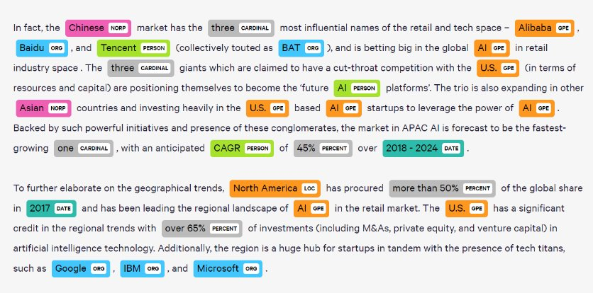


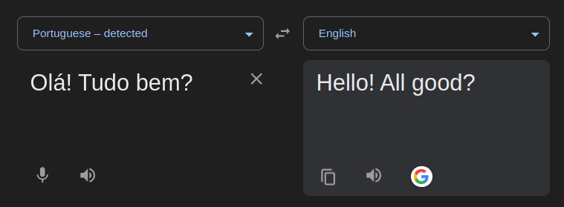
Natural Language Processing: Applications

Slide 5



Natural Language Processing: How?
We need to be able to parse text: we want to divide the text in its most basic elements without losing meaning
First things first: we need to find documents to process!
Should be easy enough…
Not so fast…

Slide 6


Natural Language Processing: Corpora
Corpora: Large and structured sets of text (i.e. a collection of documents)
Words don’t appear out of nowhere…
A text is written by…
a specific writer(s), ​
at a specific time, ​
in a specific variety,​
of a specific language, ​
for a specific function.​

Slide 7
Natural Language Processing: Corpora Variations
Having an incredible variety of documents has its advantages and disadvantages
We will have a lot of different examples
All of these variations are difficult to handle..
Languages: There are 7100 different languages - with different varieties!
Genre: Scientific paper, Romance novel, Biography, News article
Code Switching: Very prevalent on social media!
“I absolutely love a tua roupa nova”
“Bonjour! How are you?”

Slide 8



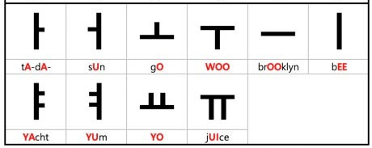
Natural Language Processing: Writing Systems
Another challenge is handling different writing systems: We do not all use the same alphabet to communicate/write!

Slide 9

Assuming that we finally have our corpora…
How do we determine how many words are in a sentence of one of the documents? How many words are there in a given corpus?
How do we parse the text?

Slide 10
Word Tokenization
Tokenization involves dividing the text into smaller, meaningful units termed tokens. Every NLP task requires text normalization:
Tokenizing (segmenting) words
Normalizing word formats: standardizing text
Segmenting sentences
After tokenizing and parsing the text, we’ll have a vocabulary! (i.e., the set of all unique individual tokens in the corpus)
Based on Prof. João Magalhães WiSDom Slides

Slide 11
Word Tokenization: Space-based tokenization
A very simple way to tokenize​: We’ll be splitting text in individual words based on spacing!
Just
Tokenizer
Splits the text into individual words
“Just do it”
do
it

Slide 12
Word Tokenization: Limitations
Punctuation: We can’t just crudely remove it.
Ph.D. - $45.55 - 03/10/2023 -#lxmls
Clitic: Words that don't stand on their own.
“are” in “we’re”, French “je” in “j’ai”, “le” in “l’honneur”
Multiword expressions: When should they be divided? (if ever)
New York - Barack Obama - Credit Card

Slide 13
Data-driven Tokenization
Given these limitations, we can leverage data to learn how to tokenize!
Instead of relying on predetermined linguistic rules, the tokenizer learns from the patterns of the data how to tokenize the words
Tokens can be part of words as well as whole words: we can use subword tokens
Tokens do not have to be entire words!
Unhappiness → ["un", "happy", "ness"]

Slide 14
Byte Pair Encoding
Initially, the vocabulary is the set of all individual characters
{A, B, C, D,…, a, b, c, d….}​
Let the corpus be:
“May the Force be with you”
“There's no place like home.”
“I'll be back.”

Slide 15
Byte Pair Encoding
1
2
3
Choose the two symbols that are most frequent in the training corpus
Merge them and add the merged symbol to the vocabulary
Replace everything by the merged token in the corpus
“b”
“e”
“b” + “e” = “be”
“b”
“e”
K
Repeat this until k merges have been done
“be”

Slide 16
Byte Pair Encoding
Remarks:
This is a subword algorithm: It can easily handle out of vocabulary words!
There’s a special symbol for end of word: We add “_” at the end of each word in the training data to mark where words end. This helps the model know where words end, so it doesn't mistakenly merge common words into a single token.
“I am, I am, I am, I am (..)”
I_, a, m_
I_ am_

Slide 17

Exercise Time

Slide 18
World Normalization
We need to standardize the words:
- U.S.A. or USA? - e-mail or email?
Casing
Stemming
Lemmatization
It may all be standardized to lower casing but…
What about U.S vs “us”?
Removes word affixes crudely!
running →run
university → univers
Represents words as their root form (their lemma)
am, are, is → be
run, running, runner,
runners →run

Slide 19
What comes next?
?
Text Data
Tokenization
Normalization
After word normalization, we have ensured that different forms of a word will be treated as the same token.
Next Step: Document Representation!
What Comes Next?
Once words are normalized, we need a way to represent entire documents for computational analysis.
The goal is to transform text into structured formats that algorithms can process.

Slide 20
Document Representation

Slide 21


Document Representation
After the text processing, we must represent words in a way that computers can understand: we need numbers!
Hello!
?
?
?
Each document needs to be transformed into a structured format based on the vocabulary and transformed into a numerical representation

Slide 22
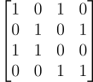
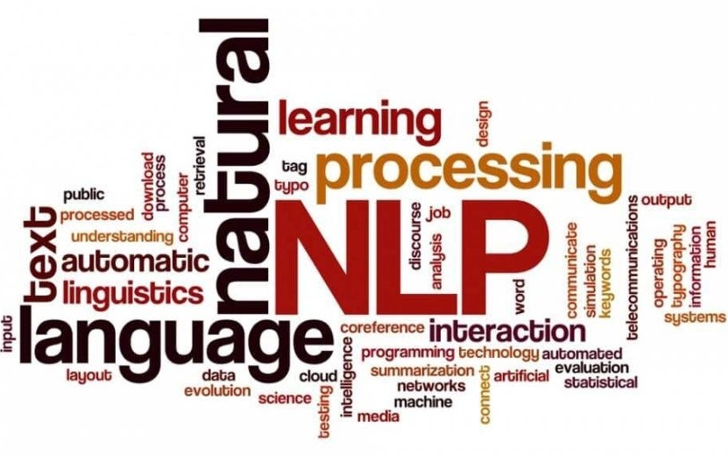
Document Representation: How?
1
3
Bag of Words
Word Embeddings
2
Tiger
TF-IDF
Lion
Parrot

Slide 23
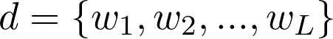
Document Representation: Bag of Words
1
It counts the frequency of a given word in the document.
Result: Each document is represented by a vector of unigrams, bi-grams…
The scale of the dimension represents the frequency of the token in that document!

Slide 24
Bag of Words: Example
1
Corpus:
Document 1: “A dog in a park”
Document 2: “A cat in a house”
Vocabulary | Document 1 | Document 2
a | 2 | 2
dog | 1 | 0
cat | 0 | 1
in | 1 | 1
park | 1 | 0
house | 0 | 1
Document 1: [2, 1, 0, 1, 1, 0]
Document 2: [2, 0, 1, 1, 0, 1]

Slide 25
Bag of Words: Limitations
1
Ignores word order: "A park in a dog" would result in the same vector as "A dog in a park."
Sparsity: As the vocabulary grows, the vectors will become sparser (i.e. with more 0s)
Common words dominate: Words like "the", "is", "of" often have the highest count! Without stop-word removal, these frequent but uninformative words can overwhelm meaningful ones

Slide 26
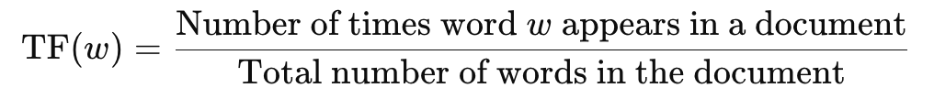
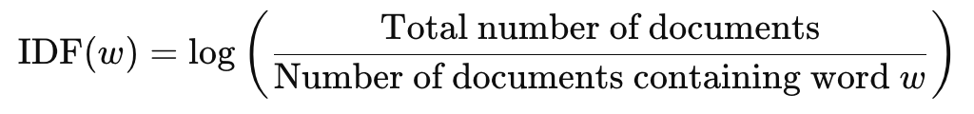
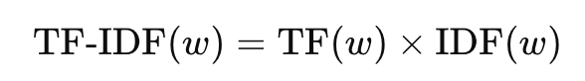
Term Freq. - Inverted Document Freq. (TF-IDF)
2
It evaluates how important a term is in a document relative to a collection of documents.
Term Frequency (TF): Measures the frequency of a word in a given document
Inverse Document Frequency (IDF): Measures the rarity of the word across the corpus
Final Term:

Slide 27
Vector Space Model

Slide 28
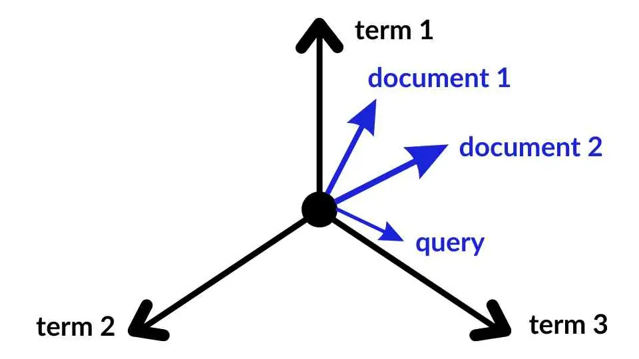
Vector Space Model
Each document d can be represented as a vector of TF-IDF values, with one component per term.
This creates a vector space where:
Terms are axes​
Documents are vectors
Retrieval: Given a document d, find other documents that are "similar" to it.

Slide 29
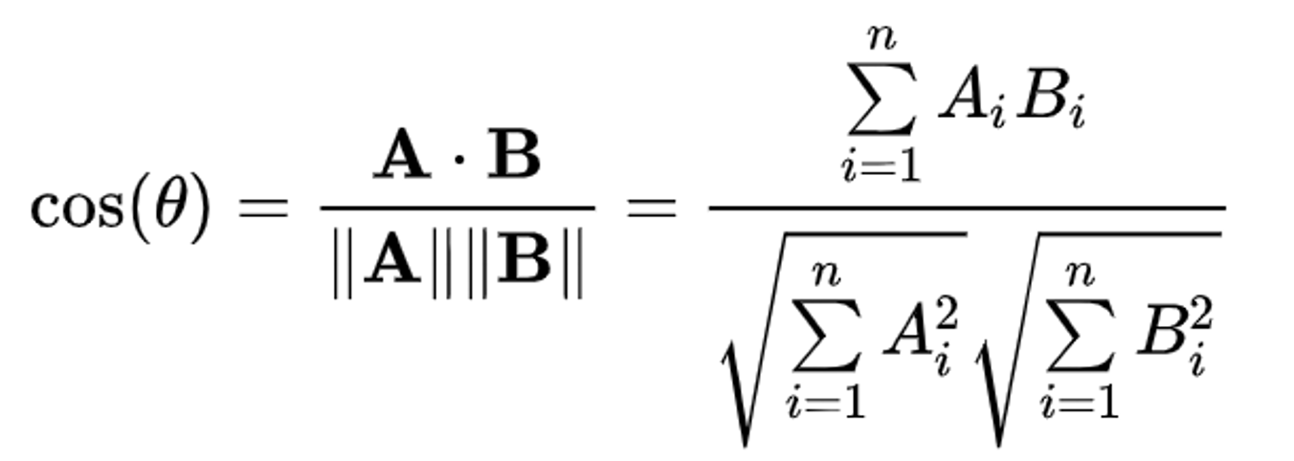
Vector Space Model
The distance between vectors d₁ and d₂ is captured by the cosine of the angle between them.​
Vector Normalization (Norm=1): Longer documents do not get more weight

Slide 30
TF-IDF: Limitations
STILL no semantic understanding: Handles “car” and “automobile” as different terms.
Sparsity: As the vocabulary grows, the vectors will become sparser (i.e. with more 0s).
STILL ignores word order: "A park in a dog" would result in the same vector as "A dog in a park.”
STILL overlooks context: TF-IDF does not take into account the context in which words appear.

Slide 31
How can we improve our word representation?

Slide 32
Word Embeddings
3
All document representation methods that we’ve seen so far have involved checking the frequency of terms. What if instead…
… we could represent words as dense vectors that are finally able to capture:
The word’s meaning
The context in which the word occurs
Semantic relationships

Slide 33
Word Embeddings: How?
3
Basically, word embeddings handle the limitations we’ve discussed so far by representing each word as a dense vector that captures semantic information.
But how?
Words with similar meanings occur in similar contexts
COUNT
PREDICT

Slide 34
Word Embeddings: How?
3
Word Embeddings: Dense vectors with continuous values that are trained by exposing a model to a large amount of text data and adjusting the vector representations based on the context in which words appear.
Encode semantic meaning
Capture relationships between words.
Skip Grams
word2Vec
Negative Sampling

Slide 35
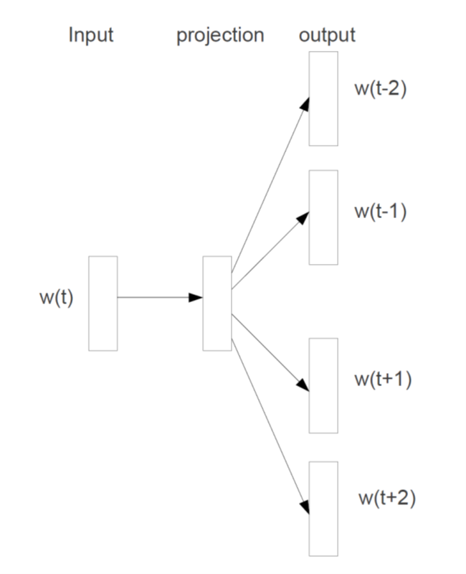
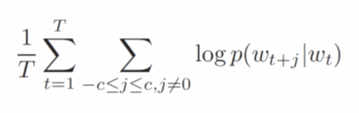
Word Embeddings: Skip-grams
3
Goal: Predict the context words given a target word.
The model will maximize the log-likelihood:​
little
hiding
cat
in
A little cat hiding in the tree close by.​
the

Slide 36
Word Embeddings: Negative Sampling
3
Positive Samples: maximize the likelihood of the pairs
Words that occur in the neighborhood
“card” → “bank”; “credit”; “debit”; “game”; “student”
Negative Samples: minimize the likelihood of the pairs
Randomly sampled from the corpus
“card” → “sky”; “mine”; “headphones”; “hat”
Facilitates training
Discriminative
Rare

Slide 37
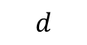



Word Embeddings: How?
3
Skip-grams + Negative Sampling finds a dense vector word for each word in the vocabulary (V_{w}).
Each vector has d latent dimensions (usually 300)
It learns TWO matrices simultaneously: a word matrix and a context matrix
cat
cat

Slide 38
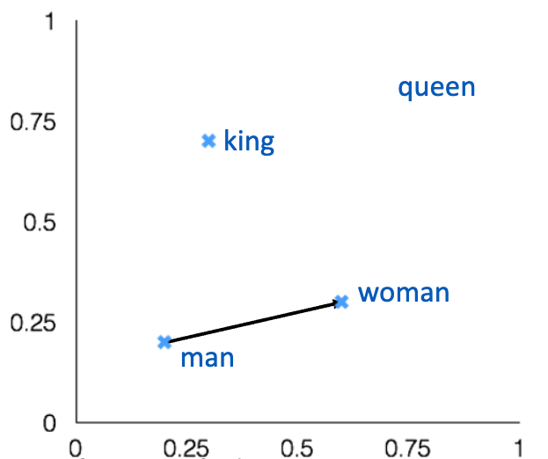
Word Embeddings: For what?
3
These models are incredibly good at capturing notions of similarity! We can use vector operations in the embedding space to check for similarity analogies!
x_{apple} − x_{apples} ≈ x_{car} − x_{cars} ≈ x_{family} − x_{families}
king [0.30 0.70]
man [0.20 0.20]
woman [0.60 0.30]
queen [0.70 0.80]
​
Based on slides from Christopher Manning, Distributed word representations for IR, Stanford University, USA

Slide 39
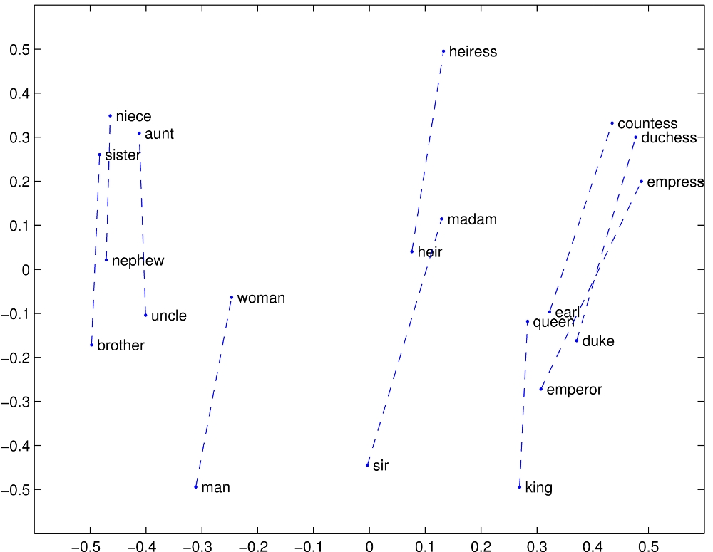
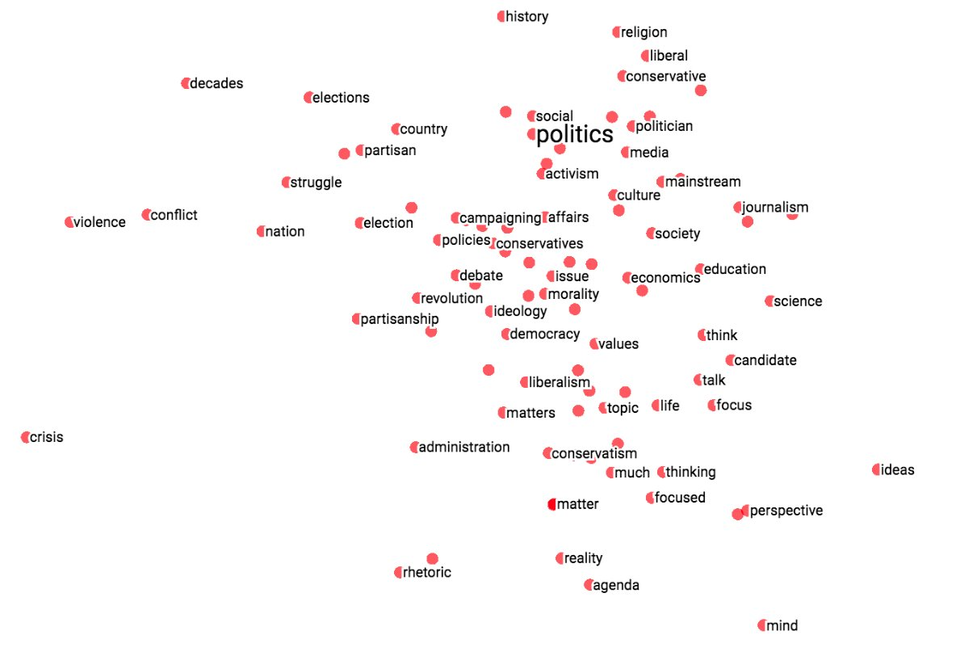
Word Embeddings: For what?
3
Based on slides from Christopher Manning, Distributed word representations for IR, Stanford University, USA

Slide 40
Exercise Time

Slide 41
Word Embeddings: Limitations
3
Static Embeddings: Word sense disambiguation; polysemy
Word tokens: Does not incorporate subword information - raises issues with out-of-vocabulary words
Context: It only learns from word co-occurrences! It does not capture context-dependent meaning
“I run a company”
“I run every morning”
Based on slides from Christopher Manning, Distributed word representations for IR, Stanford University, USA

Slide 42
Contextual Embeddings: The Novelty
Static word embeddings do not capture the context in which the word appears. However, the same word in different contexts may have different meaning/purposes.
“I run a company”
“I run every morning”
Each word vector needs to attend to its context
Attention Mechanism

Slide 43
The Transformer Architecture

Slide 44


Transformer
The transformer explores the self-attention mechanism.
Computes the importance of each word in relation to all others in the input sequence.
Computed over the entire sequence, in both directions.
Foundation for modern NLP models.
Encoder
Decoder
Vaswani, A. (2017). Attention is all you need. Advances in Neural Information Processing Systems.

Slide 45
Encoder: An Overview
Input Processing
Encoder Layers
Outpus
Tokenization
Word embeddings
Positional embeddings
Self-Attention
Multi-head Self-Attention
Normalization + Residuals
Feed Forward
Contextual embeddings
Special tokens

Slide 46
Input Processing: Pipeline
Tokenization: The text is tokenized using a data-drive tokenization approach (like BPE!)
Word Embeddings: Obtain a dense vector representation for each token
Positional Encodings: Adds positional information to the embeddings
3
2
1

Slide 47
Input Processing: Positional Encodings
The word embeddings do not contain information regarding position!
We need positional encodings that contain sequence information. These are computed from the position in the sequence and the dimension of the vector
We sum the positional encodings to the word embedding vectors in order to move them according to their position in the sequence

Slide 48
Encoder Layers: Self-Attention
Capture long-range dependencies and relationships within input sequences
Allows updating the input embeddings by integrating relevant information from other tokens in the sequence.
Self-Attention vs Attention: Attends to the input sequence itself instead of attending to an external context

Slide 49
Encoder Layers: Self-Attention
Each input position computes attention weights over all other positions in the sequence.
These attention weights determine how much each other position should contribute to the representation of the current position.
The output embedding is a weighted combination of all the input embeddings
jumps
The
The
jumps
lazy
lazy
=
Att
,
.
. . . . +
Att
,
.
The
quick
brown
fox
jumps
over
the
lazy
dog
.

Slide 50
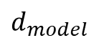
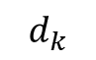
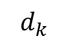
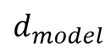
Self-Attention: Let’s break it down
Given a sequence of token embeddings X, the model computes queries (Q), keys (K), and values (V) by applying learned linear transformations:
Queries
Keys
Values
Q
X
.
W_{Q}
K
X
W_{K}
V
X
W_{V}
.
.
Sequence length
=
=
=

Slide 51
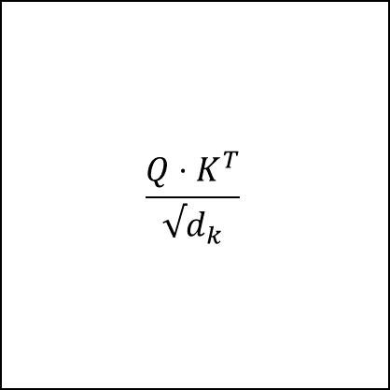
Self-Attention: Let’s break it down
X^{T}
W_{K} ^{T}
K = X*W_{K}
For each token in X:
We query the keys of all tokens (keys) and compute their attention weights.​
​
The token will be the value of all tokens weighted by their corresponding attention.
X
W_{Q}
Q = X*W_{Q}
Attention
weights

Slide 52
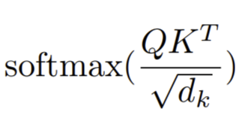
Scaled Dot-Product Attention
X^{T}
.
X^{T}
W_{K} ^{T}
The
=
quick
.
K = X*W_{K}
brown
brown
dog
fox
W_{V}
jumps
=
over
X
The
the
quick
quick
lazy
quick
brown
dog
fox
.
W_{Q}
=
jumps
.
=
Q = X*W_{Q}
V = X*W_{V}
head_{i}
over
the
lazy
Normalized attention weights
dog

Slide 53
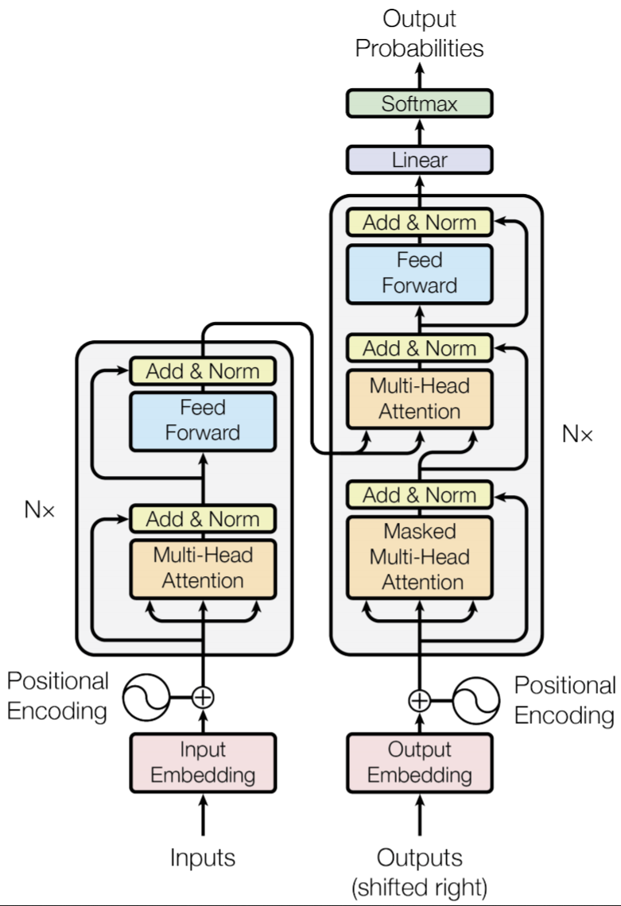
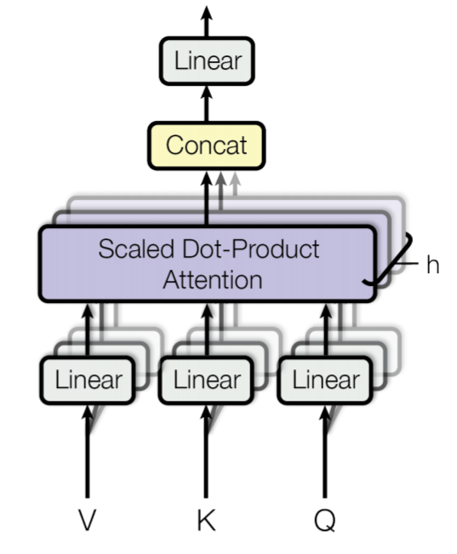
Encoder Layers: Multi-Head Attention
Transformer Layer
Multi-Head Attention
Multi-head attention is an extension of the self-attention mechanism used in Transformer models.
It allows the model to focus on different parts of the input sequence simultaneously.
Provides a richer and more nuanced modeling of the data.
N layers
. . .

Slide 54
Encoder Layers: Multi-Head Attention
Embedding dimension
Wº
weight matrix that projects the concatenated vector back into the original embedding space
W^{O}
. . . . . . . .
.
=
MultiHead
MultiHead
head₂
head₁
head_{h}

Slide 55
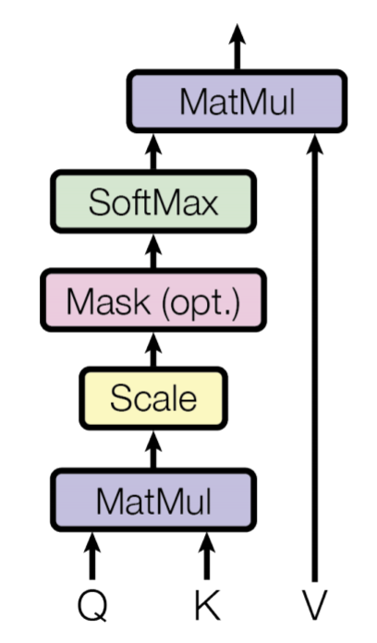
Encoder Layers: Overview
Transformer Layer
Multi-Head Attention
Single-Head Attention
N layers
. . .
h heads

Slide 56
Encoder Layers: Add & Norm
X
X
Z₁
Normalization:
Stabilizes the learning process by ensuring the outputs have a consistent scale and distribution.
Multi-Head
Residuals: Helps retain the original input information (input and positional)

Slide 57
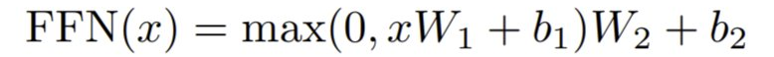
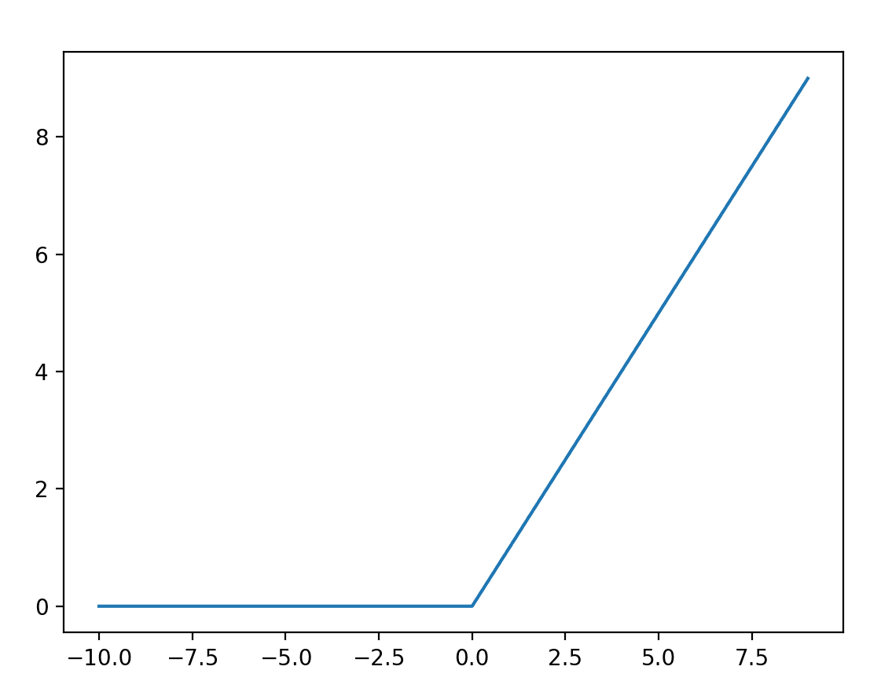
Encoder Layer: Feed Forward
FFN(Z₁)
ReLU(Z₁ W₁)
W₂
=
.

Slide 58
Multiple Layers… Multiple Interactions!
As we go up in layers, more abstract interactions will be captured!
Token Relationships
Dependencies across tokens
…
Grammar
Semantic Meaning
Layer 0
Layer 1
Layer 2
Layer N
Low-level patterns
Deeper
Interactions

Slide 59


Transformer: Applications
Text Classification
Named Entity Recognition
Question-Answering
Sentiment Analysis
Identifying entities like people, organizations, and dates in a sentence
Encodes both the question and the context to extract the answer.
Determining if a review is positive or negative

Slide 60
Exercise Time

Slide 61

Thank you!

